Slide 1
AccountaBuddy
By Elizabeth, Jake, Aadila

Slide 2
Intro to Website
Small but growing app-based accountability service
Assists people with staying on track with their personal and professional goals
Fitness
Work projects
Personal development
And many more
App matches users with accountability partners to keep them motivated
Offers monthly check
Goal-setting resources
Progress tracking through app
Notes:
Include screenshots from accountabuddy website throughout slideshow

Slide 3
Current Issues involving the Current Website
Gaining new users
Potential users have difficulty learning about service before downloading app
The minimal web presence makes it hard for potential users to discover the app
Without a well-organized, intuitive design, potential users may leave before downloading the app.
Maintaining current user size
Current users lack central place to interact outside mobile platform
Lack of a web platform limits interaction and reduces long-term user retention
Website is “bare bones” and lacks functionality
Does not have a full-fledged website.
Users can’t engage or track progress outside of the mobile app.

Slide 4
Features the present related sites have
Get focused space
Has ample showcase of app features and UI to entice potential customers
It also has a larger and more descriptive blog section, for reviews and recent customer support.
Boss as a service
Has different tools to help you understand why you procrastinate.
They promise they will not stop contacting you until you finish the task.
Has an in-depth description of how their website works.
What Users are Looking for in this Market
Simple, easy-to-navigate goal-tracking tool
Customizable and motivating features
Quick access to progress charts and reminders
How Users Normally Interact in this Market
Set personal goals and track progress regularly
Receive reminders and notifications to stay on track
Use apps primarily, but web interfaces provide a more complete view

Slide 5
Proposed Improvements
To increase visual appeal and traffic flow to the site, We suggest improvements
Optimization of website organization and services
A longer and more functional Blog post/ user testimonials
A collection of images of the functionality of the sites
Dedicate sections to highlight key features like accountability partner matching, progress tracking, and goal-setting
Offer downloadable resources, like goal-setting worksheets or motivational guides
A web-based dashboard for users to track their goals
Simple sign up process
Better sharing tools to increase growth
Needs an engaging user-friendly website
Must explain service and funnel users to app store for downloads
Must Have images of the app and functions to allow an easier showcase of features

Slide 6
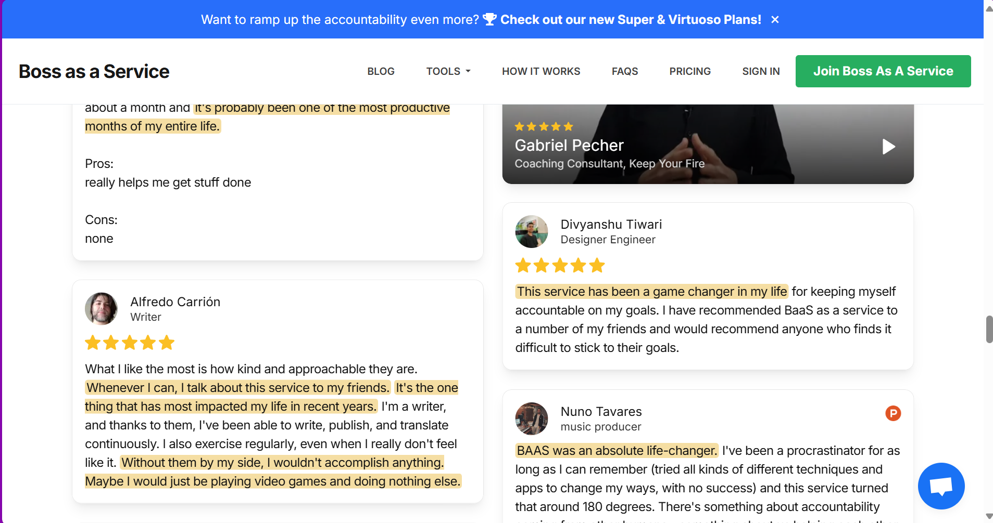
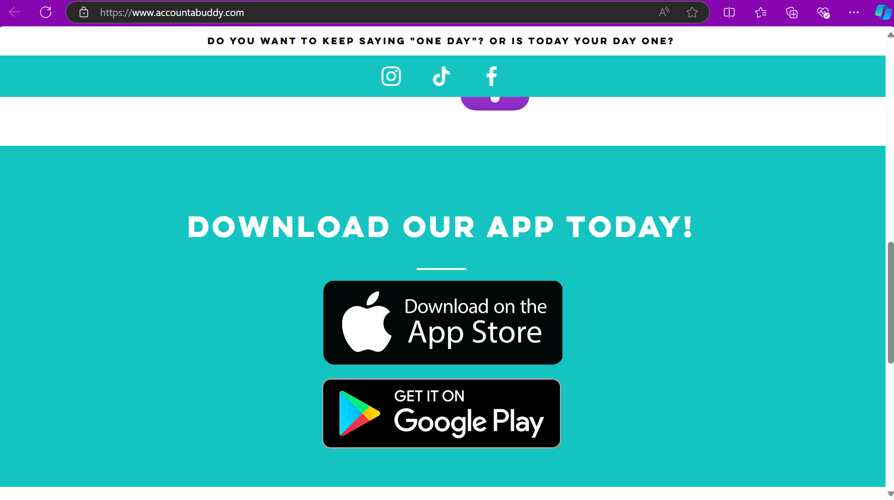
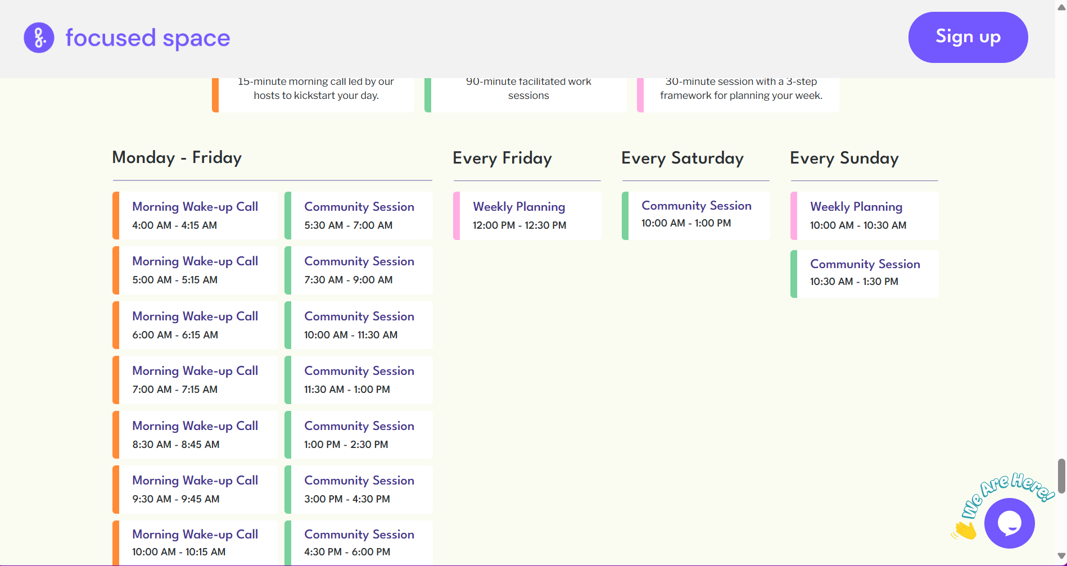
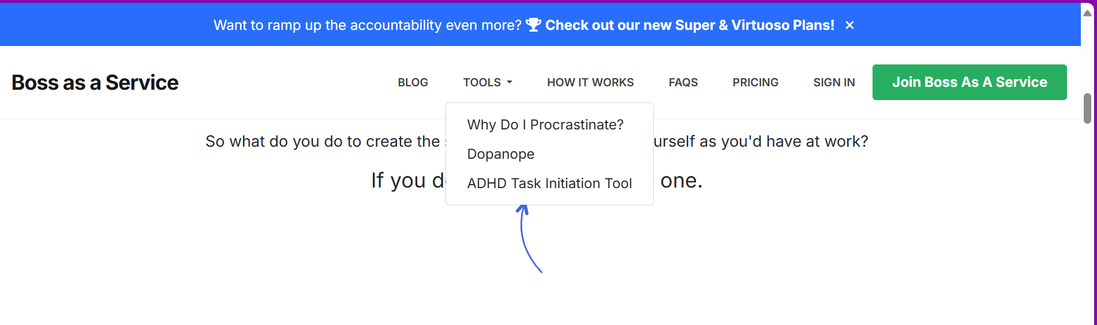
Notes:
Split this up into multiple slides and add text descriptions

Slide 7
Sources / References
https://www.accountabuddy.com/
https://get.focused.space/
https://bossasaservice.com
Notes:
Include items from each website we liked/took inspiration from
Market research - what is the app market?
pull in stats from field the app is in
Introduce info about market
Market they haven’t touched (and size) and how to reach it

